Slide 1


Dynamic Memory Allocation
Pushpa G, Assistant Professor
Department of CSE, RR Campus, PES University, Bangalore.

Slide 2
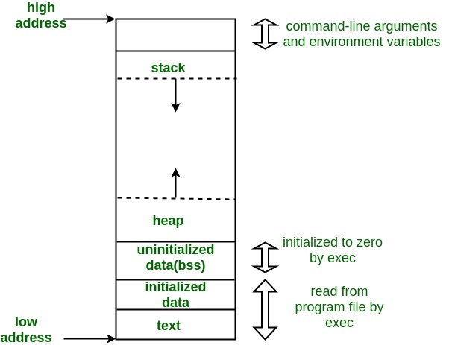
Memoroy layout of running program

Slide 3
Dynamic Memory Allocation process
A procedure in which the size of a data structure is changed during the runtime.
01
Four library functions provided by C to facilitate dynamic memory allocation
02
Malloc()
Calloc()
Realloc()
Free()
03

Slide 4
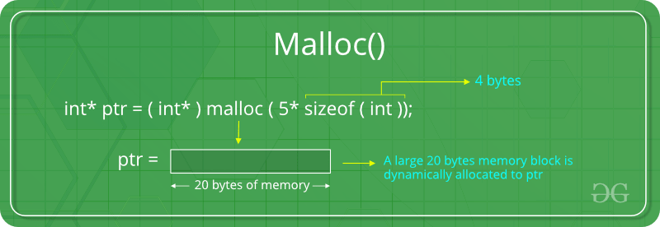
malloc()
Synatx: ptr = (cast-type*) malloc(byte-size)
Ex:ptr = (int*) malloc(100 * sizeof(int));

Slide 5
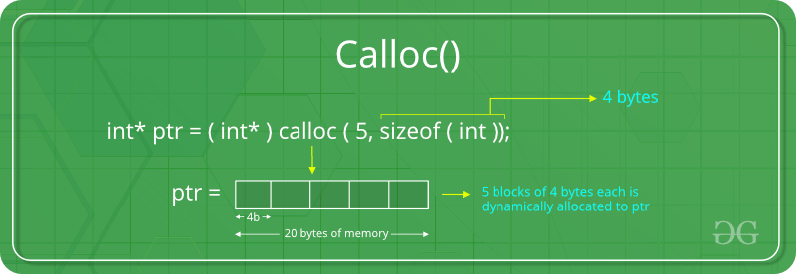
calloc()
Syntax: ptr = (cast-type*)calloc(n, element-size);
Ex:ptr = (float*) calloc(25, sizeof(float));

Slide 6
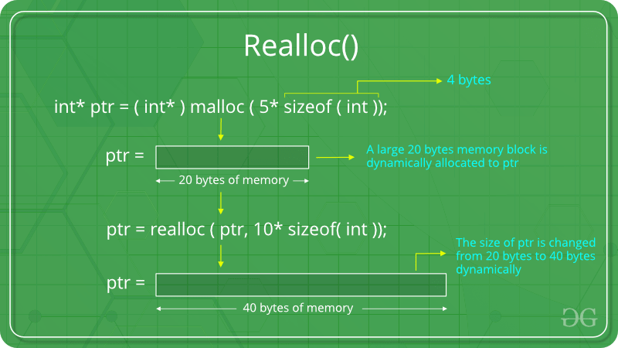
realloc()
Syntax:ptr = realloc(ptr, newSize); where ptr is reallocated with new size 'newSize’.
Ex:

Slide 7
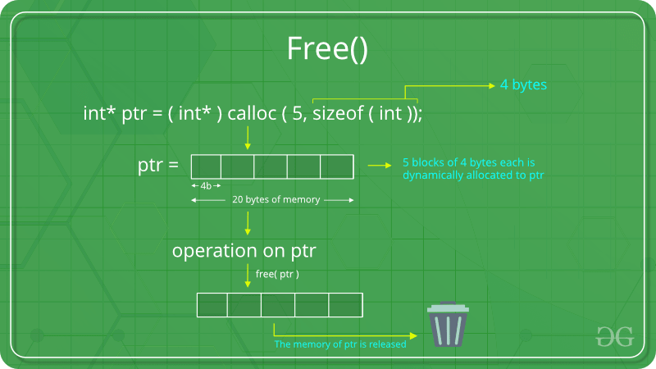
free()
Syntax: free(ptr);
Ex:

